Slide 1
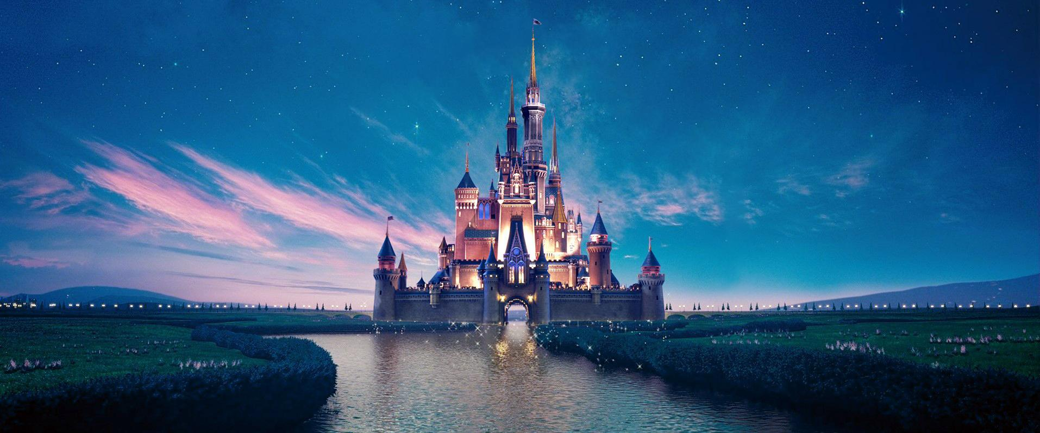



Johana - Loredane - Maïlys - Nicole

Slide 2
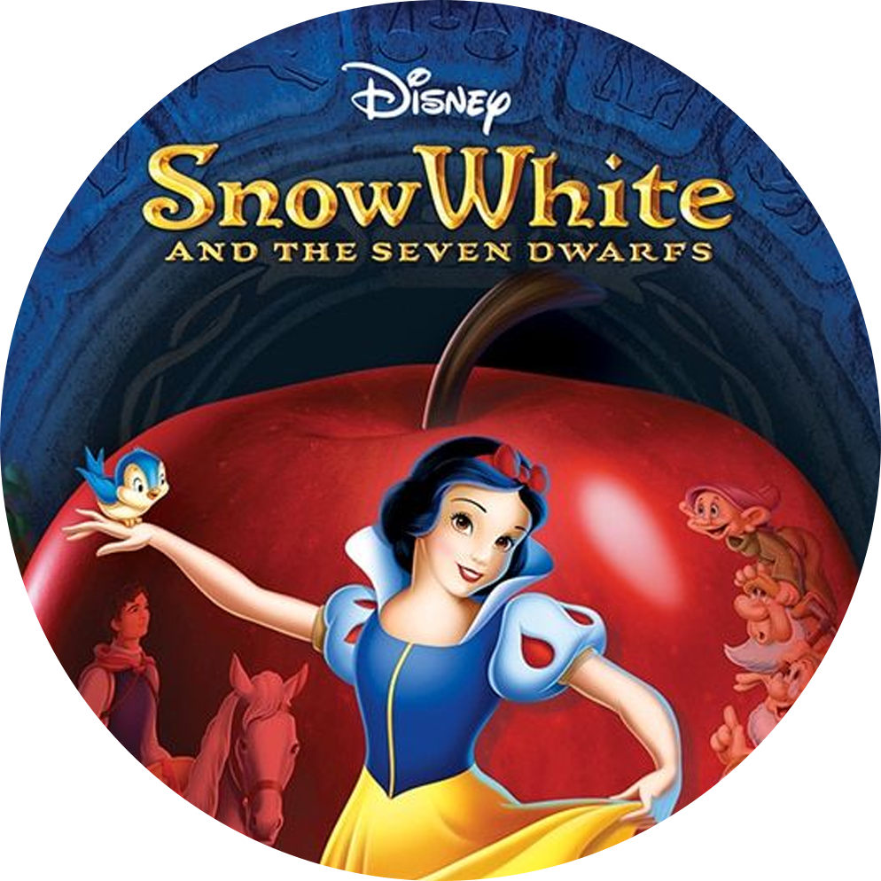
Project Overview
This project aims to explore the various factors that may influence the popularity of movies produced by Walt Disney.
What influences the popularity of a Disney film ?
Hypothesis
3. Hypothesis
2. Hypothesis
Are movies that are based on books more popular?
Is there a relation between popularity and running time?
Does the critical reception via IMDB affect box office performance?
Notes:
We used google docs and trello to monitor our progress and work daily. In terms of flow we brainstormed — found the datasets —- cleaned using python — made the ERD diagram — SQL —-visualizations in python and then finally used a combinations of both tools to analyze and draw insights.

Slide 3
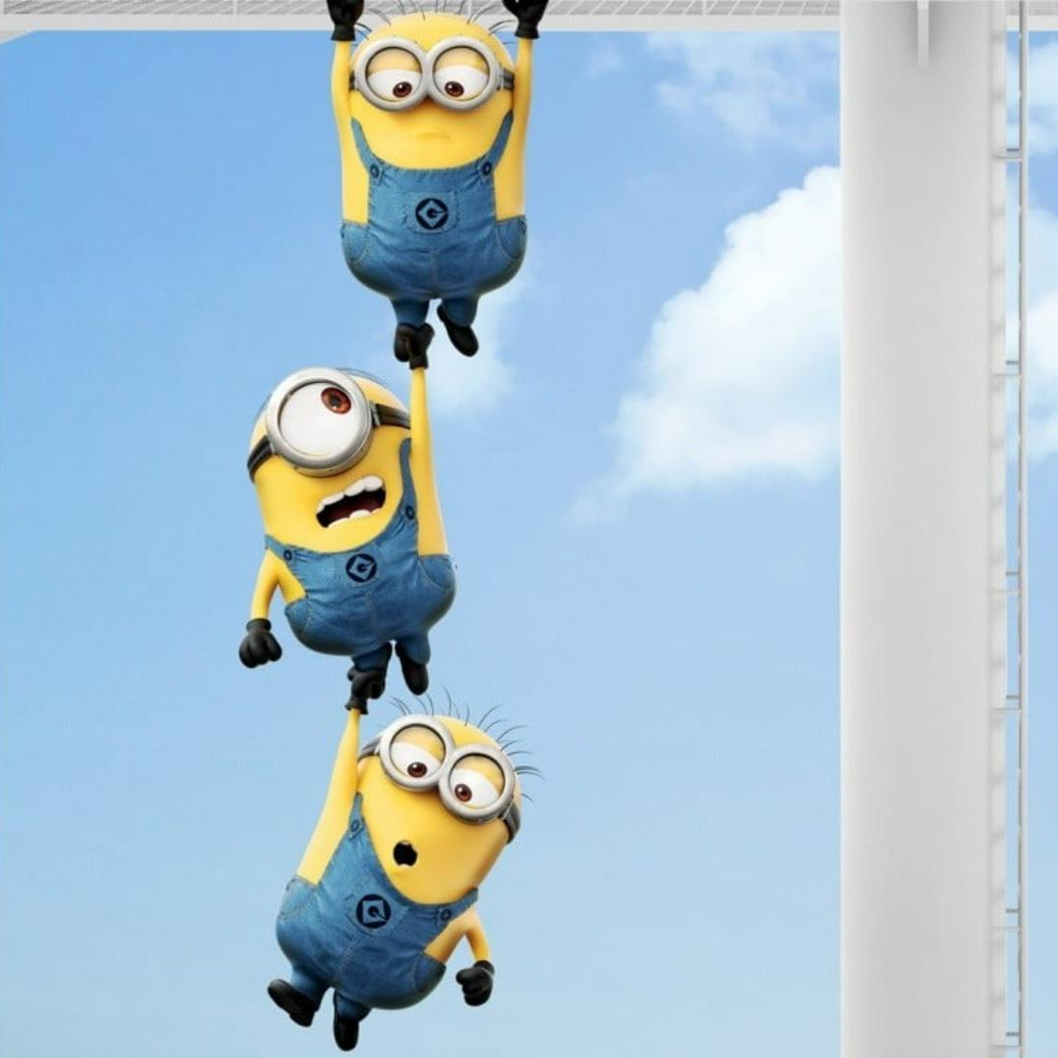


Data Acquisition, Enrichment and Examination
Primary Dataset: Overview of Disney movies (1937-2021)
Secondary Dataset: Movie genres
01
Challenges:
Data availability
Integration Complexity
This led to our data set reducing from 441 rows to 160 rows
02
Notes:
We had a fairly clean dataset to begin with. Turns out many have worked on this topic. But we still had few minor challenges like:
Data availability in both data sets. This led to our dataset reducing from 441 rows to 160. But we decided to go ahead because our goal was to practice the skills of the tools we learnt so far
Merging datasets with different structures, such as combining movie details with genre classifications, involved careful handling to maintain data integrity.

Slide 4
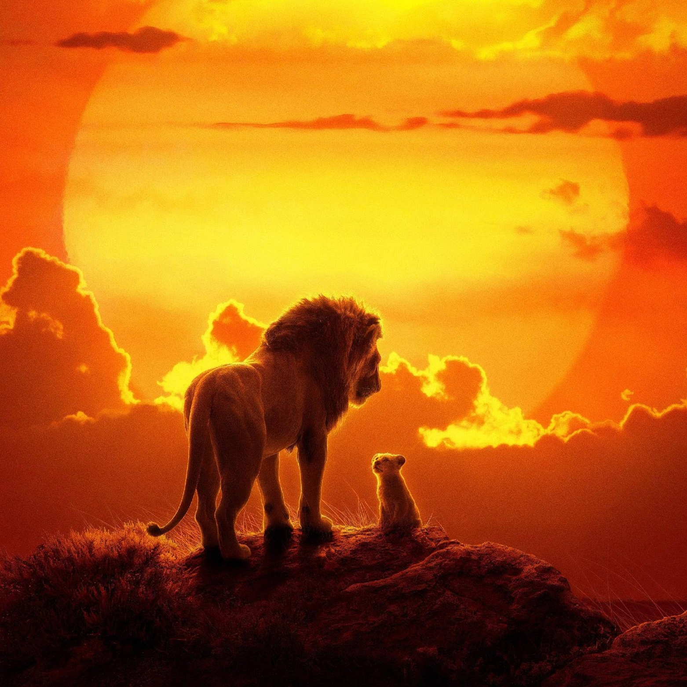
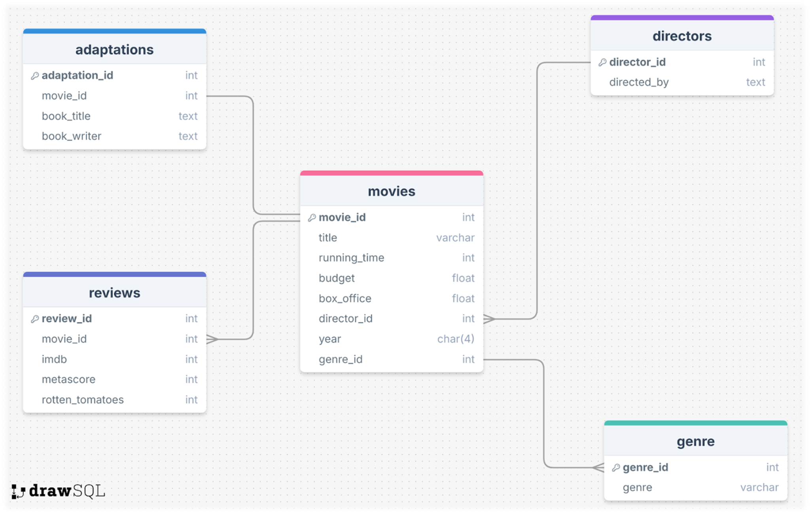
Database Design & Data Transformation

Slide 5
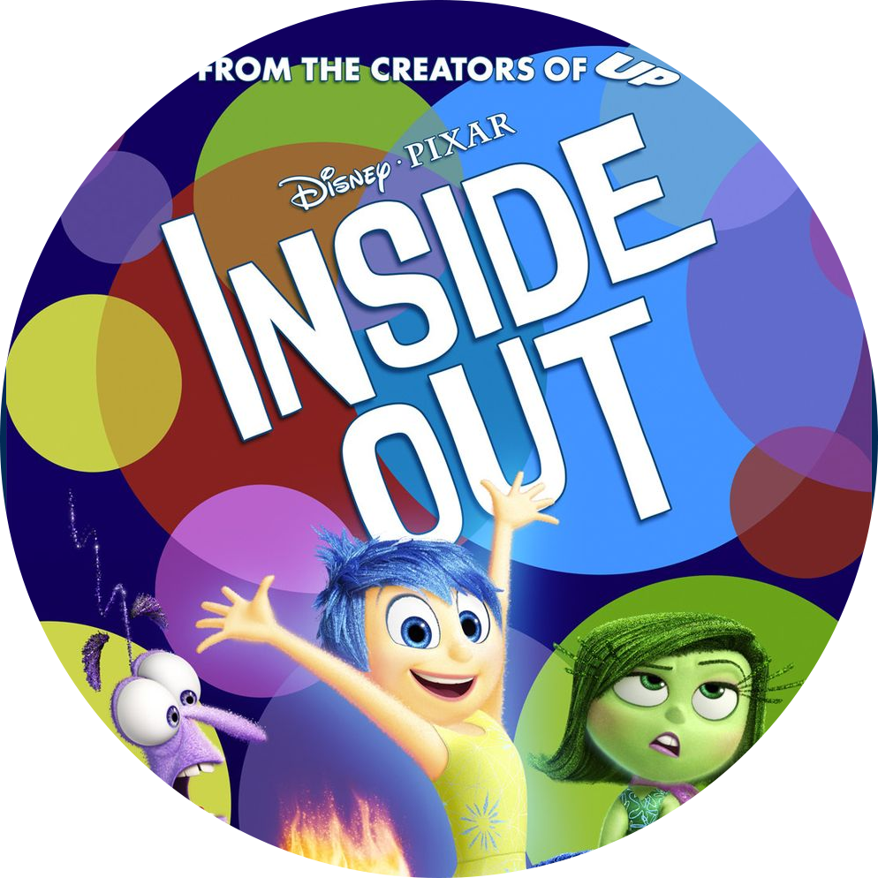
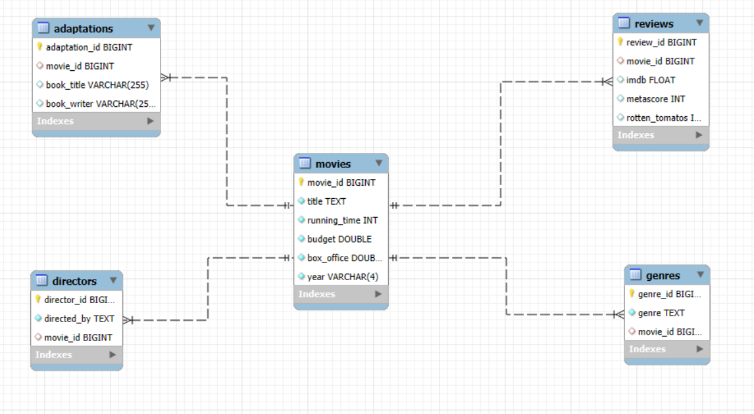
Challenges faced during the data sourcing and integration.
Database Design & Data Transformation

Slide 6
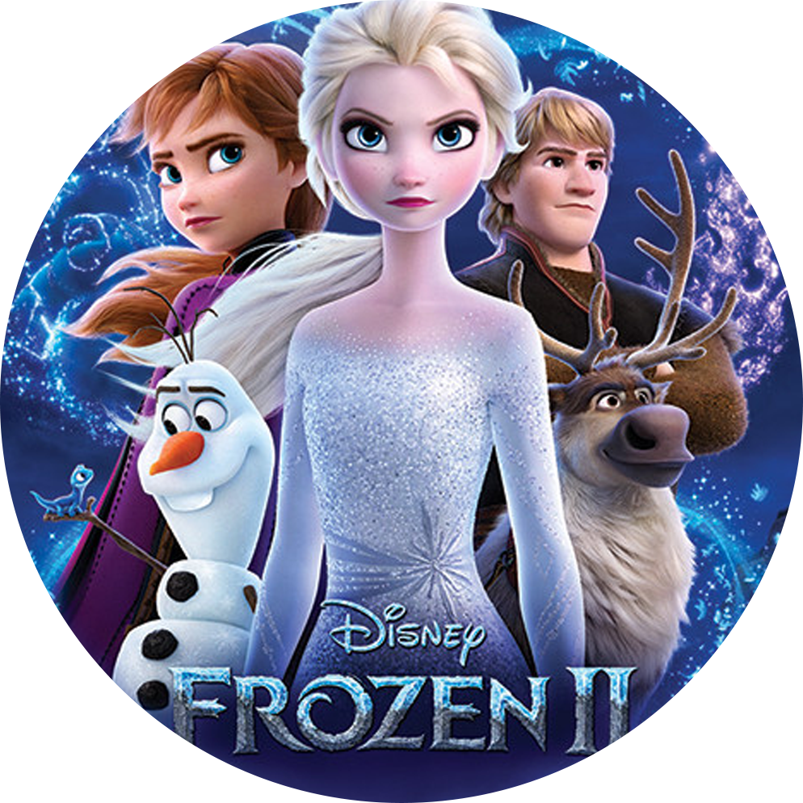

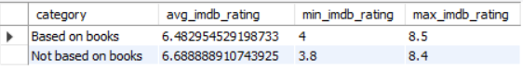
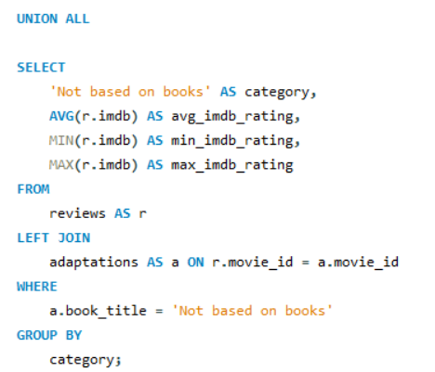
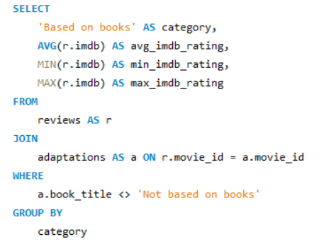
SQL Insights & Advanced Analysis

Slide 7
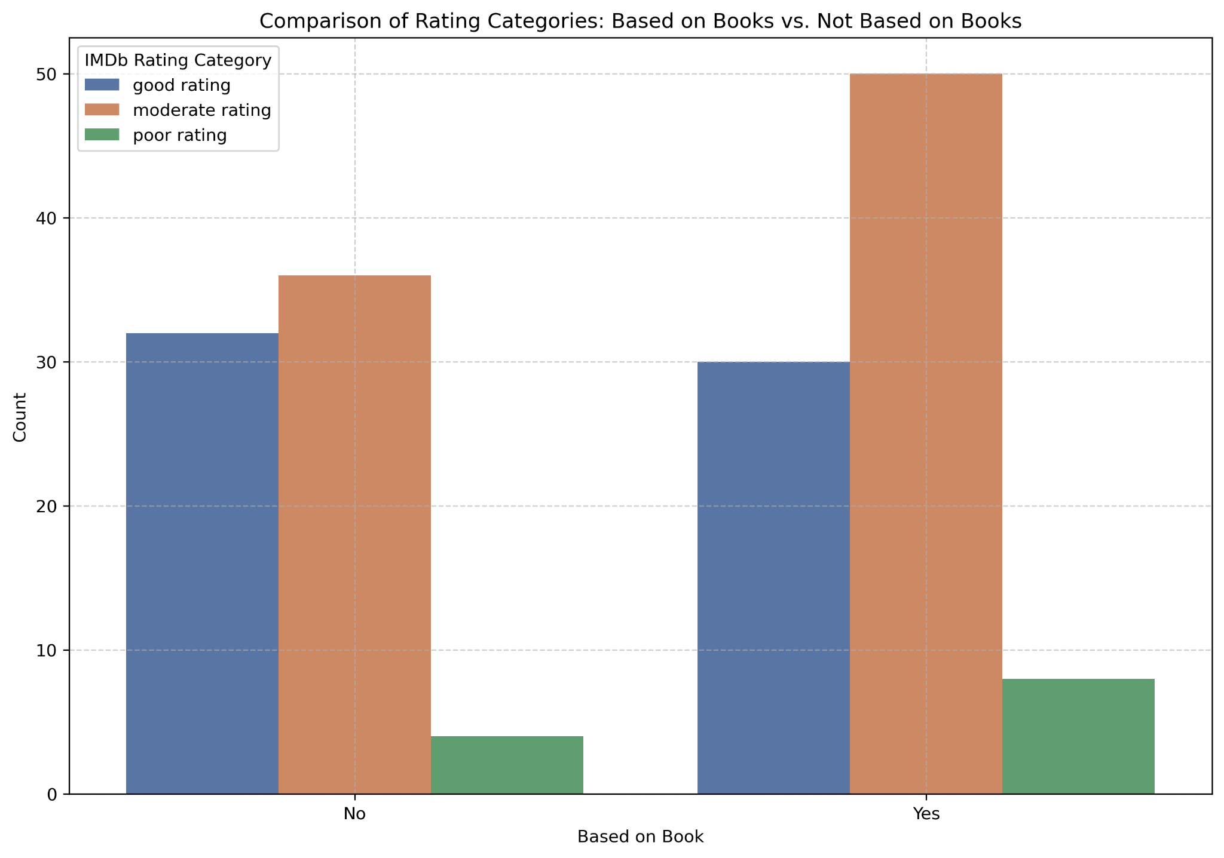
Visualisation & Key Insights
3. Hypothesis
Visualisation & Key Insights
Are movies that are based on books more popular?
Notes:
Categorized the imdb ratings into good, moderate and poor and then we saw that movies based on books had more positive reviews and ratings than those not based on books

Slide 8
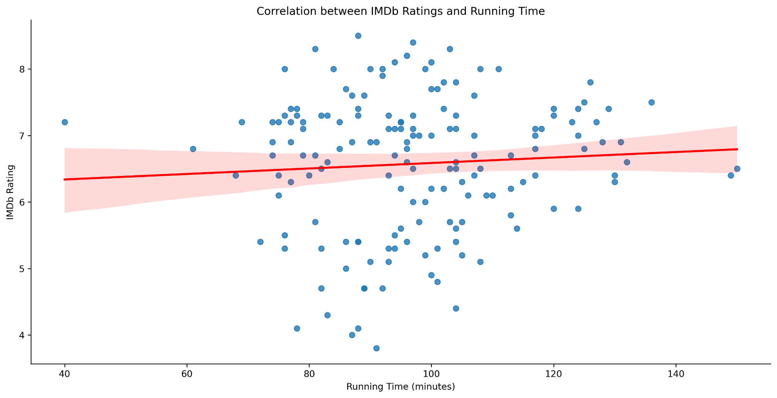
2. Hypothesis
Visualisation & Key Insights
Is there a relation between popularity and running time?
Correlation = 0.069
Very weak
Notes:
#relationship is very weak between running time and ratings
#slight upward slope of the regression line - a slight tendency for longer movies to receive higher IMDb ratings
#wide spread of points - other factors are likely more important in determining IMDb ratings than just the length of the movie.

Slide 9
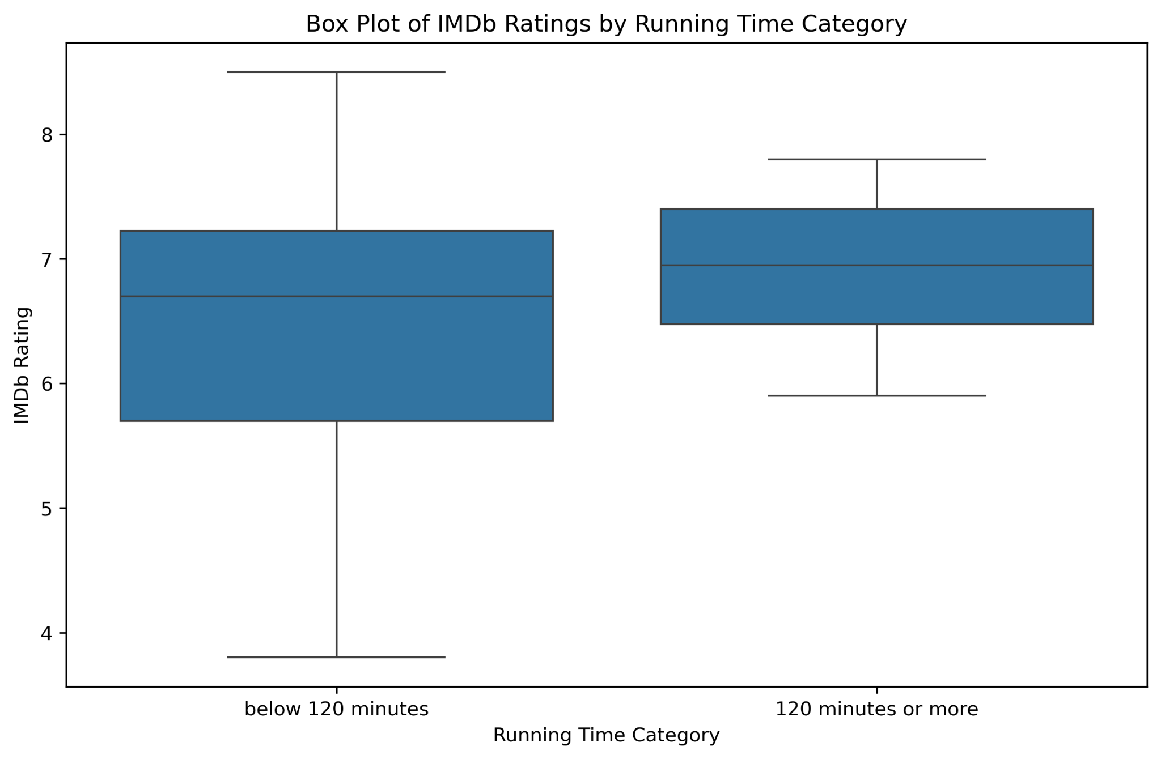
2. Hypothesis
Visualisation & Key Insights
Is there a relation between popularity and running time?
Notes:
The plot suggests that while longer movies generally receive more consistent and slightly higher ratings, gave us an idea about the distribution of the data
# shorter movies have a more diverse range of ratings, including some lower-rated films.
# while shorter movies might vary more widely in audience reception.
# longer movies tend to be more favorably received or possibly that they are more consistent in quality,

Slide 10
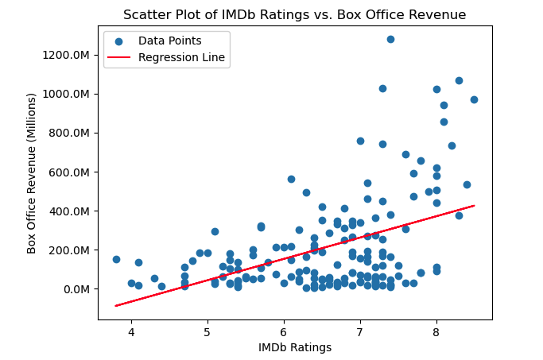
3. Hypothesis
Visualisation & Key Insights
Does the critical reception via IMDB affect box office performance?
Correlation = 0.448
→ Moderate positive correlation

Slide 11
Major Obstacle and Challenges
Key challenges:
Importing the CSV to MySQL, Workbench with the right format
One member could only load 50 of 160 entries.
The "Review" table loaded when we ran the script individually but failed when all scripts ran together.
01
02
03

Slide 12
Major Obstacle and Challenges
Lessons Learned:
Diagnostic check: Regularly inspect the CSV file
Attention to details: Importance of meticulous data preparation
Do not give up: Keep trying and practising till you succeed

Slide 13
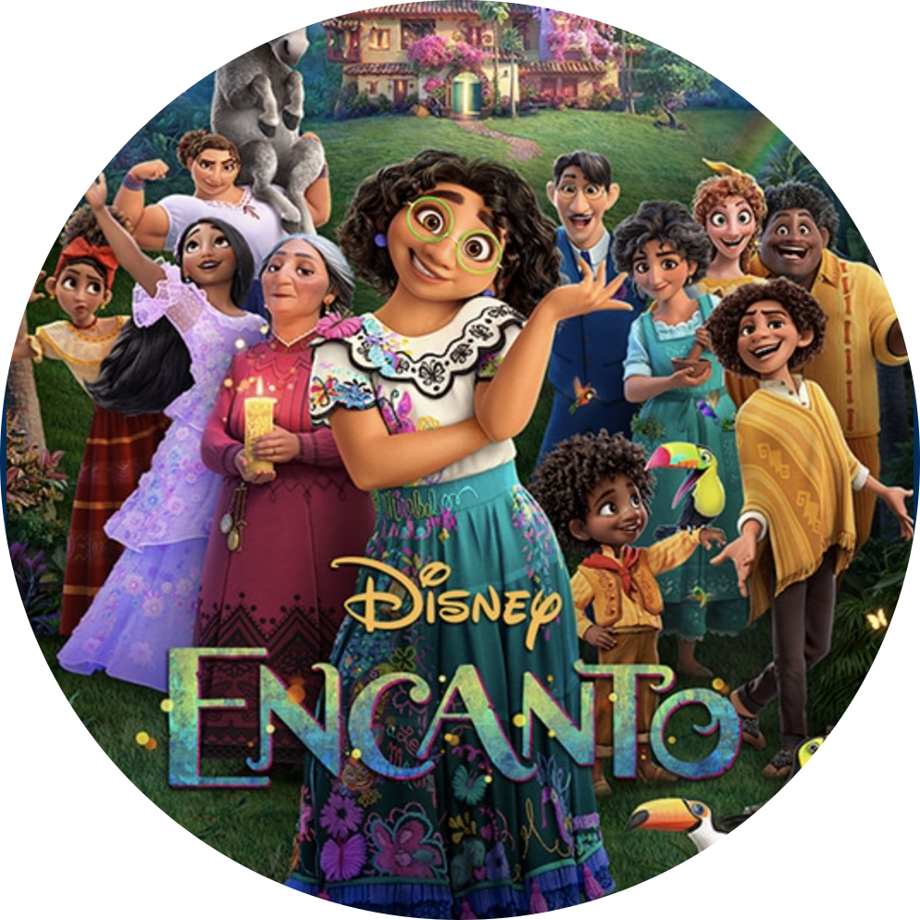
Conclusions & Business Implications
Critical Reception & Box Office: ✔️ Higher critical scores often lead to box office success, suggesting that critical acclaim influences financial outcomes.
Running Time & Popularity: ✖ Weak correlation between popularity and running time; length of the movie does not affect popularity.
Impact of Source Material: ✔️ Movies based on books tend to have higher IMDb ratings, indicating that existing fanbases boost popularity.
Notes:
Our analysis of Disney movies revealed several key insights :

Slide 14
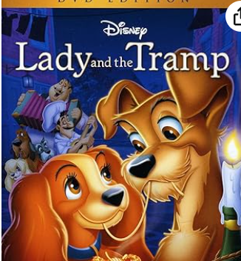
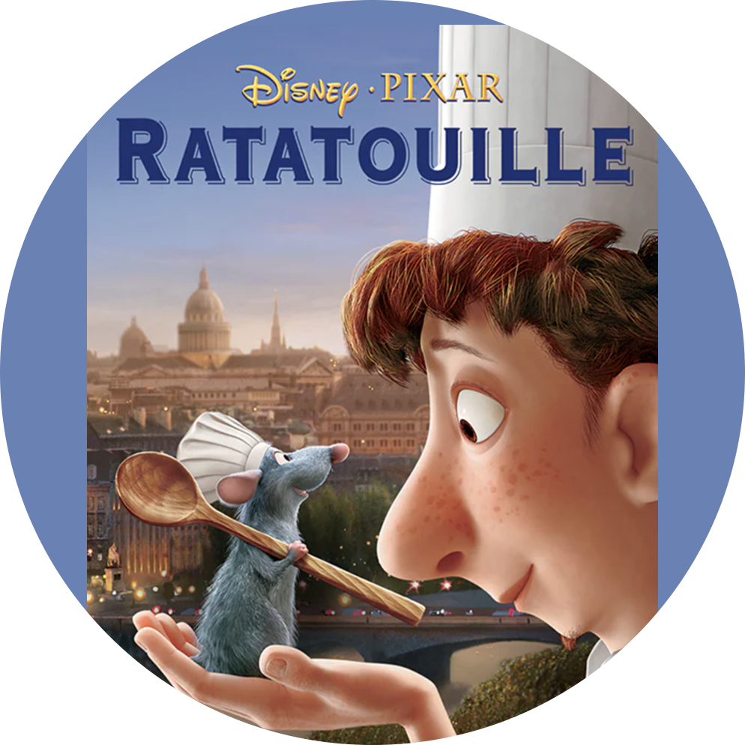
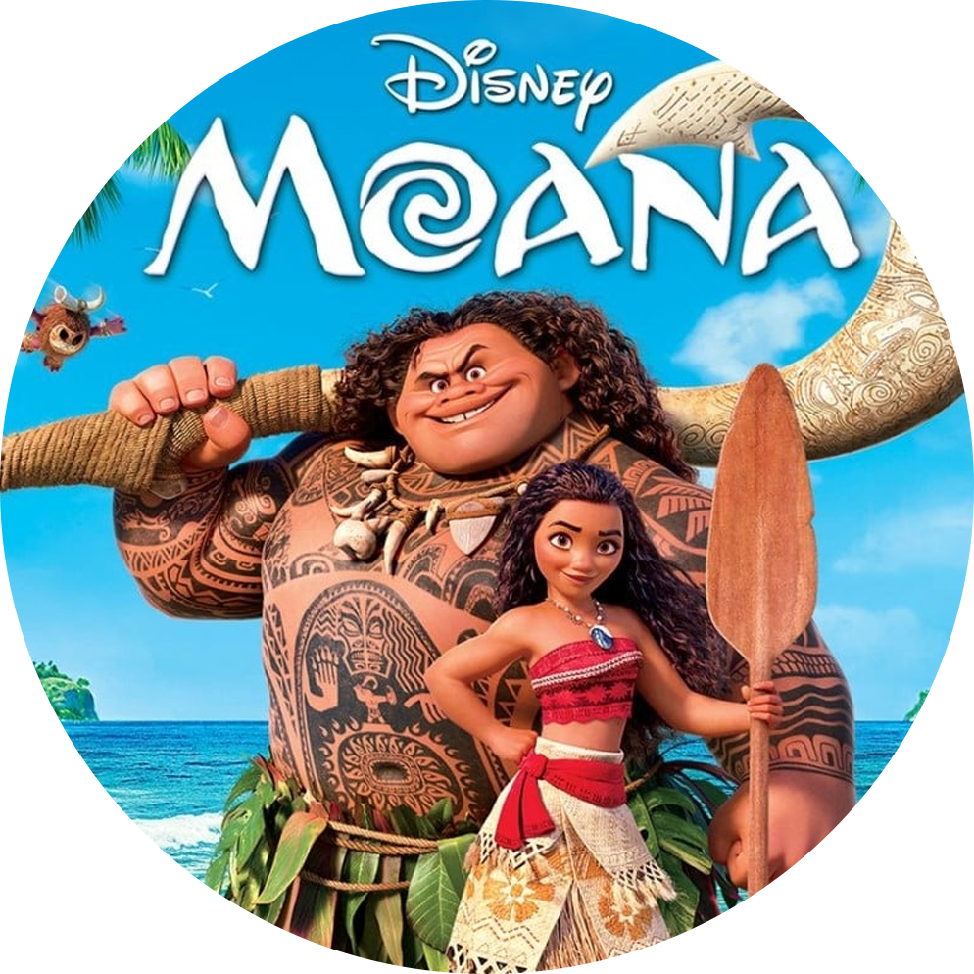
“It's kind of fun to do the impossible.”
THANK YOU
Johana - Loredane - Maïlys - Nicole

